Slide 1
REGULATIONS AND COMPLIANCE
ITMS 528
By Divine Puplampu

Slide 2
Introduction
Regulations and industry standards are complex
It creates serious problems for organizations
Trying to meet their governance requirements
International standard that are designed to help companies meet these requirements
And enhance their performance measure.
Regulatory and legal obligations may assist organization in their use of IT

Slide 3
Regulatory Compliance
Is a legal subjects with which the organization has to comply
As well as industry standards
It involves devising internal policies and procedures to enable the organization comply with industry standards
The laws and regulations governing its activities

Slide 4
Data Security
They are required to devise protocols
To ensure that their policies for sharing, storing, retaining data for operational use
Comply with the laws and regulations governing data retention
To keep important data for future use or reference
While data that is no longer needed is disposed
Must be organized in such a way that it may be searched and accessed at a future date

Slide 5
U.S. Federal Government legislation enacted (Some laws)
Fair Credit Reporting Act of 1970 (FCRA)
Fair Debt Collection Practices Act of 1977 (FDCPA)
Controlling the Assault of Non-Solicited Pornography and Marketing Act (CAN-SPAM) of 2003
Fair and Accurate Credit Transactions Act of 2003(FCRA as Amended)
Regulates the gathering, dissemination, and use of consumer information

Slide 6
Regulated companies for consumers info
Equifax, Transunion, and Experian
Database companies such as
LexisNexis, ProQuest, and Westlaw are required to comply with the FCRA
Because they provide information about users to banks and insurance companies
FDCPA also protects consumers from abusive debt collection practices

Slide 7
Federal Information Security Management Act of 2002 (FISMA)
Requires the various government agencies or appointed commissions :
To develop and implement programs that guarantee information security and govern the information systems.
Focus on the importance of developing an appropriate “risk-based policy for cost-effective security
Program officials of the agencies are required to conduct annual reviews of their information security programs
Private organizations to require their various constitutive
To develop and implement programs that guarantee information security
Organizations have to comply with a wide array of regulations in this regard.

Slide 8
Sarbanes-Oxley Act of 2002
Public Company Accounting Reform and Investor Protection
Require organizations to demonstrate that a chain of integrity exists
The compliance data has neither been tampered with nor subjected to unauthorized disclosure
In this context :
The compliance data is the set of data that is relevant to implement a law or validate compliance
Requires organizations to build and use frameworks for monitoring, controlling and mitigating risk

Slide 9
Payment Card Industry Data Security Standard
Established to increase controls on organizations that handle credits from the major card
MasterCard, Visa, and American Express
To minimize fraud via exposure of the personal information of consumers
Compliance with standard is not mandatory under federal law
States such as Minnesota, Nevada, and Washington have incorporated the standard into their laws

Slide 10
Federal Trade Commission
Securities Act of 1933
Promote consumer protection and eliminate anti-competitive business practices
Securities Exchange Act of 1934
Powers to regulate the securities market on the Securities Exchange Commission

Slide 11
Gramm-Leach-Bliley Act of 1999
Requires financial institutions to provide their clients with a privacy notice
Explain what information they are obtaining
Where the information is shared
How it will be protected from foreseeable threats in security
Consent to the obtaining and use of information.
Client’s right to opt out of the private information being shared in accordance with the FCRA.

Slide 12
Health Insurance Portability and Accountability
(HIPAA) of 1996: Department of Health and Human Services draft rules governing the use and dissemination of such information
Guidelines for protecting the privacy and security of the health information of individuals
Creates several offences relating to the disclosure of individually identifiable health information
Rules apply to covered entities
Independent contractors
Even organizations that are not health care providers

Slide 13
Challenge for IT departments
Regulation and industry standards is complex thereby creating problems for organizations trying to meet the several requirements simultaneously
Required to ascertain how governance, risk management and compliance should be integrated and applied to the organization
Align their operations with the organization’s business and compliance strategies
Organizational structure and processes, identify and manage the risks of IT operations, leverage IT resources and enhance performance

Slide 14
Challenge for IT departments (Cont.)
They do not recommend specific processes for:
Data sharing, storing, retention and use
They simply describe expected outcomes
Specify sanctions for the failure to meet the outcomes
Some adopted common standards that seek to improve general compliance
Like International Electrotechnical Commission (IEC)
International Organization for Standardization (ISO)
COBIT developed by ISACA and the ISO/IEC 38500

Slide 15
COBIT
Acronym for Control Objectives for Information and Related Technology
Created in 1996 by the Information Systems Audit and Control Foundation (ISACF)
As evaluation IT and governance framework for the Committee of Sponsoring Organizations of the Treadway Commission (COSO)
Information Systems Audit and Control Association (ISACA) providing guidance on how to comply with regulations and mitigate business risks in IT management and governance
Enables organizations integrate the management of IT risk into the overall management of enterprise risk

Slide 16
COBIT (cont.)
High-level processes with inputs and outputs, performance measures, objective
Important process-activities and a maturity model or structured levels describing practice, processes and required outcomes
210 control objectives that have been categorized in four domains
Acquisition and Implementation
Monitoring and Evaluation
Planning and Organization
Delivery and Support

Slide 17
COBIT (cont.)
Maturity model is used as a benchmark:
For comparison of different organizations given that it aligns business objectives with IT objectives and processes
Done using three sets of integrated criteria:
The information criteria, IT resources, and IT processes
The framework enables organizations to then balance risk and control in IT investments and provides guidance for more efficient IT controls
Auditors within the organization may use the framework to identify IT risks and putting in place IT controls.

Slide 18
Framework specification
Aligns IT objectives with IT good practices and standards such as:
The Project Management Body of Knowledge, The Open Group Architecture Framework (TOGAF), Information Technology Infrastructure Library (ITIL), and ISO 27000
COBIT 5 integrates COBIT 4.1 with risk frameworks and the Business Model for Information Security (BMIS)
Organizations may therefore use the framework to measure their achievement and identify the responsibilities of process owners
Sarbanes-Oxley Act requires organizations to build and use frameworks for monitoring, controlling and mitigating risks
COBIT provides a convenient means of meeting these requirements

Slide 19
The Effectiveness of the Framework
How effective the governance framework has been due to the lack of academic scholarship on its use by organizations to meet regulatory outcomes
Most of the studies on its use were conducted by ISACA or with its support.
Organizations are supposed to allocate time and resources towards understanding the use of the framework
Incurring significant compliance costs as IT personnel in an organization are required to take sufficient time off to train and assess how the framework can be used to support IT governance and benefit the organization
How the framework may be aligned with the organization’s IT policies and procedures
Assess the organization’s performance every day by aligning its strategies to 300 key performance indicators

Slide 20
The Effectiveness of the Framework
Management Guidelines and Implementation Guidelines state that the framework should be customized to the specific environment.
The framework minimized disruption and unauthorized alterations
It is simply a reference frame comprising standards proposed by experts
The objective is to enhance the management of risk and performance measurement
Guides them towards developing the right approach for implementing IT governance initiatives

Slide 21
ISO/IEC 38500
Originally developed by Standards Australia
Consists of a structure of principles guiding members of the board of directors, owners and the senior management towards the efficient assessment and monitoring of IT in their organizations
The standard enables the senior managers of organizations to understand and fulfil their ethical and regulatory obligations in regard to the organization’s use of IT
Must be directed and monitored from the top echelons of the organization
Use the standard to evaluate the present and future use of IT
Align the plans and policies governing the use of IT with business objective
Monitor compliance with the relevant regulations and industry standards

Slide 22
The Effectiveness ISO/IEC 38500
Is a code of practice and not a specification
Simply guides decision making in regard to what should happen but does not specify how they should be implemented and when.
Although the objectives are similar, it does not replace control frameworks such as COBIT
With other ISO issued standards such as the ISO 27001: 2013, which measures and assess how well an organization’s information security management system is performing
Where the organization has already implemented COBIT, this would create some confusion
Enabled Organization to evaluate and direct plans for the use of IT

Slide 23
Conclusion
Organizations find it difficult to comply with the wide range of increasingly complex laws and regulations
Determine whether a governance framework and an international standard can guide organizations towards leveraging the synergies between risk management, governance and compliance, and complying with laws and regulations and industry standards
regulatory compliance
internal policies and procedures to enable an organization comply with industry standards, as well as the laws and regulations governing its activities.
organization stands to reap the most benefits (effective IT governance and compliance) where it is able to leverage ISO/IEC 38500 and the COBIT framework, since they complement each other

Slide 24
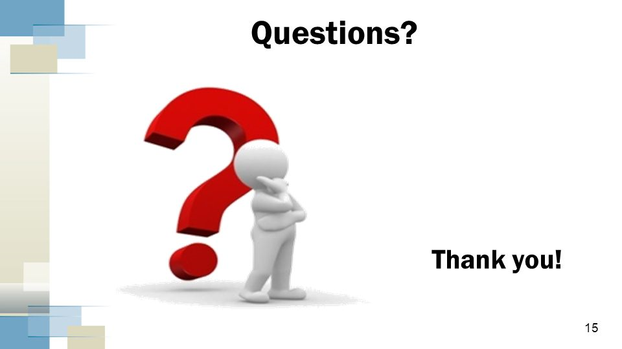

Slide 25


